Slide 1
BINARY SEARCH TREES
A binary search tree, also known as an ordered binary tree, is a variant of binary trees in which the nodes are arranged in an order.
In a binary search tree, all the nodes in the left sub-tree have a value less than that of the root node.
Correspondingly, all the nodes in the right sub-tree have a value either equal to or greater than the root node.
The same rule is applicable to every sub-tree in the tree. (Note that a binary search tree may or may not contain duplicate values, depending on its implementation.)
Look at Fig. 10.1.
The root node is 39.
The left sub-tree of the root node consists of nodes 9, 10, 18, 19, 21, 27, 28, 29, and 36.
All these nodes have smaller values than the root node.
The right sub-tree of the root node consists of nodes 40, 45, 54, 59, 60, and 65.
Recursively, each of the sub-trees also obeys the binary search tree constraint.
For example, in the left sub-tree of the root node, 27 is the root and all elements in its left sub-tree (9, 10, 18, 19, 21) are smaller than 27, while all nodes in its right sub-tree (28, 29, and 36) are greater than the root node’s value.

Slide 2
BINARY SEARCH TREES
Binary search trees are considered to be efficient data structures especially when compared with sorted linear arrays and linked lists.
In a sorted array, searching can be done in O(log2n) time, but insertions and deletions are quite expensive.
In contrast, inserting and deleting elements in a linked list is easier, but searching for an element is done in O(n) time.
However, in the worst case, a binary search tree will take O(n) time to search for an element.
The worst case would occur when the tree is a linear chain of nodes as given in Fig. 10.2.
To summarize, a binary search tree is a binary tree with the following properties:
The left sub-tree of a node N contains values that are less than N’s value.
The right sub-tree of a node N contains values that are greater than N’s value.
Both the left and the right binary trees also satisfy these properties and, thus, are binary search trees.

Slide 3
Searching for a Node in a Binary Search Tree

Slide 4
Inserting a New Node in a Binary Search Tree

Slide 5
Deleting a Node from a Binary Search Tree
The delete function deletes a node from the binary search tree.
However, utmost care should be taken that the properties of the binary search tree are not violated and nodes are not lost in the process.
We will take up three cases in this section and discuss how a node is deleted from a binary search tree.

Slide 6
Deleting a Node that has No Children
Look at the binary search tree given in Fig. 10.11.
If we have to delete node 78, we can simply remove this node without any issue.
This is the simplest case of deletion.

Slide 7
Deleting a Node with One Child
To handle this case, the node’s child is set as the child of the node’s parent.
In other words, replace the node with its child.
Now, if the node is the left child of its parent, the node’s child becomes the left child of the node’s parent.
Correspondingly, if the node is the right child of its parent, the node’s child becomes the right child of the node’s parent.
Look at the binary search tree shown in Fig. 10.12 and see how deletion of node 54 is handled.

Slide 8
Deleting a Node with Two Children
To handle this case, replace the node’s value with its in-order predecessor (largest value in the left sub-tree) or in-order successor (smallest value in the right sub-tree).
The in-order predecessor or the successor can then be deleted using any of the above cases.
Look at the binary search tree given in Fig. 10.13 and see how deletion of node with value 56 is handled.
This deletion could also be handled by replacing node 56 with its in-order successor, as shown in Fig. 10.14.

Slide 9
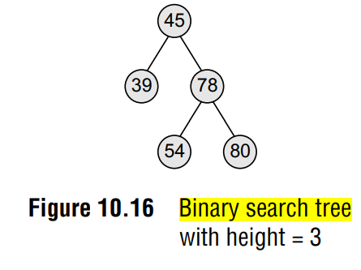
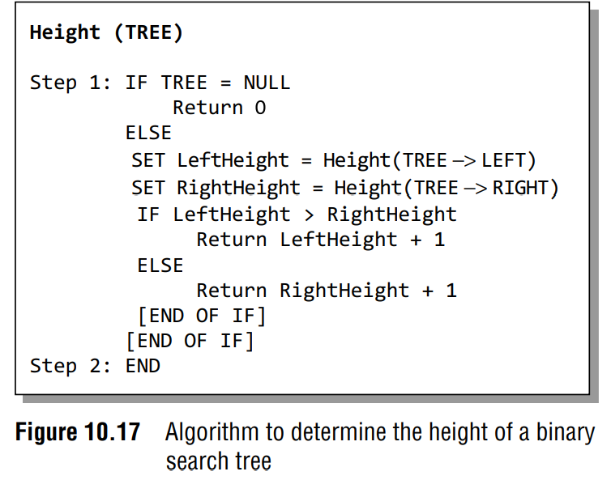
Determining the Height of a Binary Search Tree
In order to determine the height of a binary search tree, we calculate the height of the left sub-tree and the right sub-tree.
Whichever height is greater, 1 is added to it.
For example, if the height of the left sub-tree is greater than that of the right sub-tree, then 1 is added to the left sub-tree, else 1 is added to the right sub-tree.
Look at Fig. 10.16.
Since the height of the right sub-tree is greater than the height of the left sub-tree, the height of the tree = height (right sub-tree) + 1= 2 + 1 = 3.
Figure 10.17 shows a recursive algorithm that determines the height of a binary search tree.
In Step 1 of the algorithm, we first check if the current node of the TREE = NULL. If the condition is true, then 0 is returned to the calling code. Otherwise, for every node, we recursively call the algorithm to calculate the height of its left sub-tree as well as its right sub-tree.
The height of the tree at that node is given by adding 1 to the height of the left sub-tree or the height of right sub-tree, whichever is greater.

Slide 10
Determining the Number of Nodes
Determining the number of nodes in a binary search tree is similar to determining its height.
To calculate the total number of elements/nodes in the tree, we count the number of nodes in the left sub-tree and the right sub-tree.
Number of nodes = totalNodes(left sub–tree) + totalNodes(right sub–tree) + 1
Consider the tree given in Fig. 10.18.
The total number of nodes in the tree can be calculated as:
Total nodes of left sub–tree = 1
Total nodes of left sub–tree = 5
Total nodes of tree = (1 + 5) + 1
Total nodes of tree = 7
Figure 10.19 shows a recursive algorithm to calculate the number of nodes in a binary search tree.
For every node, we recursively call the algorithm on its left sub-tree as well as the right sub-tree.
The total number of nodes at a given node is then returned by adding 1 to the number of nodes in its left as well as right sub-tree.
However if the tree is empty, that is TREE = NULL, then the number of nodes will be zero.

Slide 11
Finding the Mirror Image of a Binary Search Tree
Mirror image of a binary search tree is obtained by interchanging the left sub-tree with the right sub-tree at every node of the tree.
For example, given a tree T, the mirror image of T can be obtained as T’.
Consider the tree T given in Fig. 10.22.
Figure 10.23 shows a recursive algorithm to obtain the mirror image of a binary search tree.
In the algorithm, if TREE != NULL, that is if the current node in the tree has one or more nodes, then the algorithm is recursively called at every node in the tree to swap the nodes in its left and right sub-trees.

Slide 12
Deleting a Binary Search Tree
To delete/remove an entire binary search tree from the memory, we first delete the elements/nodes in the left sub-tree and then delete the nodes in the right sub-tree.
The algorithm shown in Fig. 10.24 gives a recursive procedure to remove the binary search tree.

Slide 13
Finding the Smallest Node in a Binary Search Tree
The very basic property of the binary search tree states that the smaller value will occur in the left sub-tree.
If the left sub-tree is NULL, then the value of the root node will be smallest as compared to the nodes in the right sub-tree.
So, to find the node with the smallest value, we find the value of the leftmost node of the left sub-tree.
The recursive algorithm to find the smallest node in a binary search tree is shown in Fig. 10.25.

Slide 14
Finding the Largest Node in a Binary Search Tree
To find the node with the largest value, we find the value of the rightmost node of the right subtree.
However, if the right sub-tree is empty, then the root node will be the largest value in the tree.
The recursive algorithm to find the largest node in a binary search tree is shown in Fig. 10.26.

